Slide 1


Gossamer:
Securely Measuring Password-based Logins
Marina Sanusi Bohuk, Mazharul Islam, Suleman Ahmad, Michael Swift, Thomas Ristenpart, Rahul Chatterjee
Notes:
Hello! I’m going to talk about how to securely perform measurements on passwords submitted in login requests. This is joint work with my coauthors at Cornell and the University of Wisconsin-Madison.

Slide 2

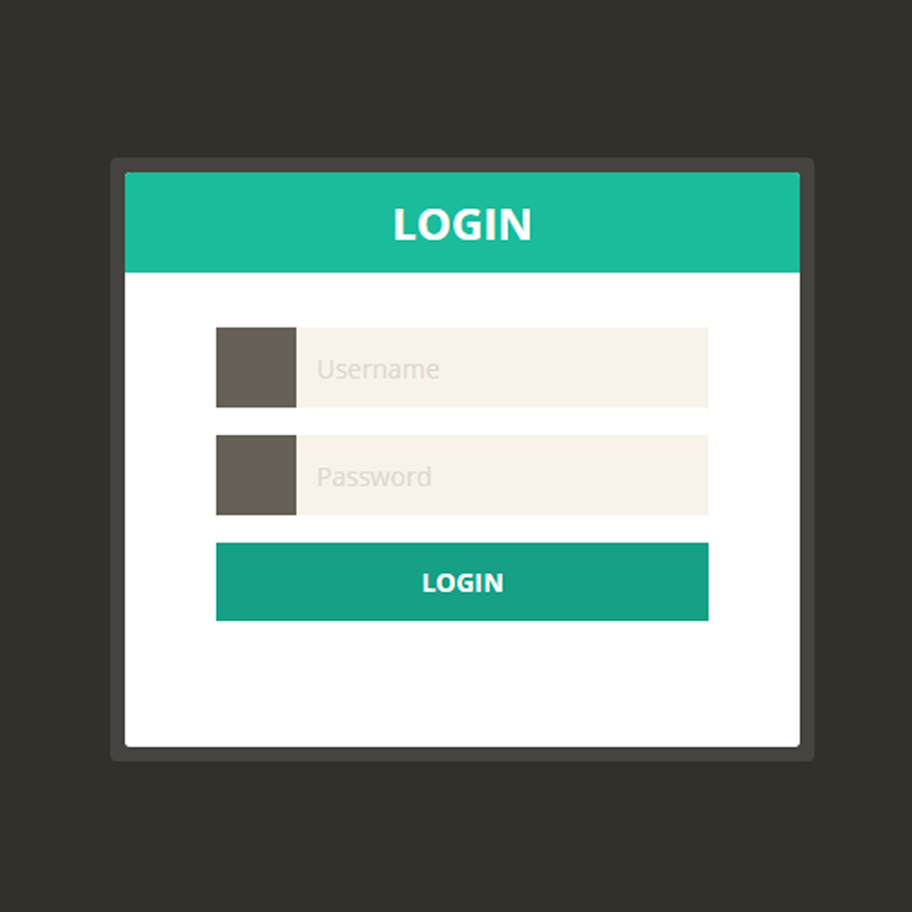
Modern Authentication Systems
Is hash(password) in the database?
username, password
Passwords are no longer sufficient!
Client
+ IP address
+ user agent
Credential stuffing is a huge source of account compromise.
Freeman et al. 2016
+ password information
How do we separate benign and malicious traffic?
How do we safely log information about actual passwords?
Tian et al. 2019
Notes:
Modern authentication systems still mainly rely on password-based logins. You probably log into your email, bank account, or social media account using a username and password, and the login client sends those credentials to the server. *When the server receives the username and password, it hashes the password and checks if the password hash matches the hash stored in the database corresponding to that username.
*However, users choose easy–to-guess passwords and reuse them across multiple web services. Therefore, attackers can compromise users’ accounts just by guessing their passwords or using the password leaked from other web services. This is called *credential stuffing, and it is a huge concern for account security. So industry practitioners are trying to rely not only on passwords. But an open question is what information can be used to differentiate benign login attempts from malicious attacks
*In a study at LinkedIn, Freeman et al. looked at using the IP address and user agent with some success. *In another study at Microsoft, Tian et al. suggested using password information and showed promising results on simulated data. * However, we would like to investigate using password-derived information from REAL login data. So the question remains, how do we safely log information about actual passwords in real login data?

Slide 3
Logging Password-Derived Measurements
Design a measurement framework (Gossamer) for use with web login systems (1.5-year-long process)
username, password
Describe a process for assessing risk of password-based measurements.
Client
Gossamer
Conduct a measurement study at two universities observing over 34M login requests.
Notes:
*In this paper, we design a measurement framework that we call Gossamer for measuring password-derived information in web login systems. This was a 1.5 year process in close collaboration with our university security engineers.
*We also describe a process for assessing the risk of individual password-based measurements via a simulation.
*And finally, we conduct a measurement study at the two universities on over 34M login requests, and we report our findings on login user behavior regarding passwords.

Slide 4
Architecture
Can we add instrumentation that looks at passwords?
student center
username, password
Single-sign-on (SSO) service
email
sanitized login request
bursar
Measurement service (VM)
Ephemeral DB
Design principles
1. Safe-on-reboot (Miklas ’09)
researcher access
pw-derived measurements
2. Periodic deletion
Analysis service (VM)
Persistent DB
3. Least privilege access
Notes:
At both universities, when a student or employee tries to log into their email, bursar, or other school-related account, they do so through a *single-sign on service that processes their login request after receiving their username and password. Thus in order to observe passwords, *we need to instrument this SSO server. However…we face a few challenges in doing so.
Challenges:
1) This service affects a lot of people.
2) We don’t want to affect the performance of the system.
3) Passwords are sensitive, so we can’t just store them.
Prior work looks at the password hash and compares it to other submissions; but this does not allow us to get insight into other characteristics of the submitted password.
How can we design a measurement service that measure information about passwords without compromising the security or performance of the login server?
*We start with a VM that receives the sanitized login request from the SSO service, including the username, password, and headers. *We adopt the safe-on-reboot principle introduced in Bunker by Miklas et al. by ensuring that passwords are never stored in plaintext on disk, so rebooting will clear all sensitive data.
In order to compare password-derived information across multiple requests, we need some form of temporary storage. *For this, we use an ephemeral MySQL db, and we encrypt the fields stored in this database with an in-memory key that expires every 24 hours. *By doing this we achieve periodic deletion, which is the second of our design principles.
* We then record the password-derived measurements taken on the ephemeral data to a persistent database which is accessible to the researchers, and we use an *analysis service to perform further analysis. We restrict access to the measurement service and ephemeral database to a subset of researchers responsible for maintaining the service; * thus we achieve least privilege access, our third design principle.
However, in the unlikely event of a compromise, it’s important that the measurements logged not reveal too much information about users’ actual passwords because the attacker could use these measurements to speed up a guessing attack.

Slide 5

Architecture
If compromised, how could attackers use password-derived measurements to speed up attacks?
student center
Single-sign-on (SSO) service
email
bursar
Encrypted username and pw
plaintext IP…
Measurement service (VM)
Ephemeral DB
Design principles
1. Safe-on-reboot (Miklas ’09)
researcher access
Encrypted username,
plaintext IP…
Pw-derived information
2. Periodic deletion
Analysis service (VM)
Persistent DB
3. Least privilege access
4. Bounded leakage logging
Notes:
So if compromised, how could attackers use password-derived measurements to speed up attacks?
If the attacker gains long term access to the measurement service, it is equivalent to compromising the SSO service where the attacker can monitor the passwords as users log in. We therefore focus on the smash-and-grab attacker which steals the stored data in gossamer.
*If the attacker steals the ephemeral data, they learn nothing as the key is deleted on reboot.
*If the attacker steals the persistent DB, though, they will gain access to the *pw-derived information. So we need to ensure that the potential benefit of these measurements is bounded—we call *this design principle bounded leakage logging.

Slide 6
How can we choose safe measurements to log?
Guess list
Gossamer logs
(Encrypted) username
Sends guess
marina
qwerty
Attacker guess list
Gossamer logs
Guess rank | Password
1 | qwerty
2 | abc123
3 | hunter
4 | jessica
5 | spider
Encrypted username | zxcvbn score
0lVB5TH | 2
gk3pPhL | 1
trZQA1L | 3
jNKR3Yp | 2
OXJFw2r | 4
5 guesses
6
Notes:
So how can we choose measurements that are safe to log?
Let’s assume that an attacker is perform a password guessing attack against a live login system. They have a *guess list of passwords, and they will iterate over the guess list trying each one until a successful login. For example, if the user’s password *is “spider”, it would take the attacker 5 guesses to correctly guess it.
We also assume now that they have access to *Gossamer logs, which contain the encrypted username and information about the pwd. In this case, for the password-derived measurements, we consider the zxcvbn score, a measure of password strength.
We assume that the attacker knows the encrypted username for the user they are trying to target; in this case, that *encrypted username is the third one on this list---trZQA1L, and the zxcvbn score of that user’s password is 3.

Slide 7
How can we choose safe measurements to log?
Sends guess
Guess list
Gossamer logs
(Encrypted) username
marina
qwerty
Attacker guess list
Gossamer logs
Guess rank | Password | zxcvbn score
1 | qwerty | 1
2 | abc123 | 0
3 | hunter | 4
4 | jessica | 2
5 | spider | 3
Encrypted username | zxcvbn score
0lVB5TH | 2
gk3pPhL | 1
trZQA1L | 3
jNKR3Yp | 2
OXJFw2r | 4
1 guess
7
Notes:
Now the attacker can compute the same score for each of the passwords in their guess list and filter out any passwords that do not have a zxcvbn score of 3. In this case, we* can filter out the first four passwords in the list, and now it would only take the attacker *1 guess from the filtered list to guess the user’s actual password.

Slide 8
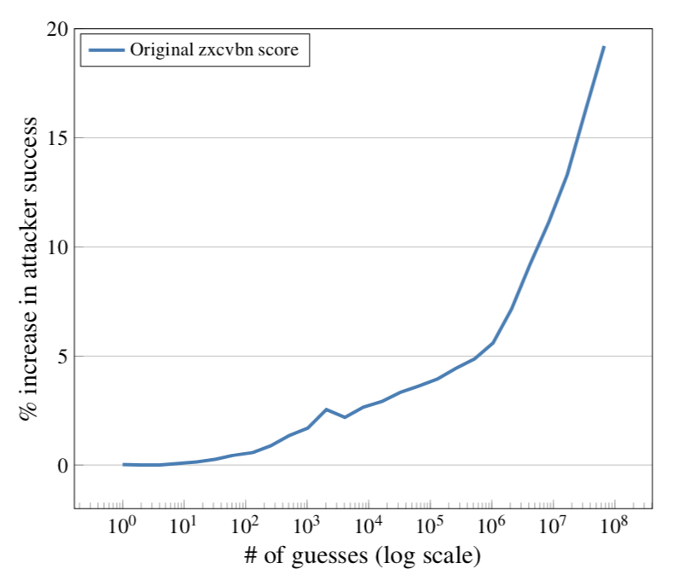
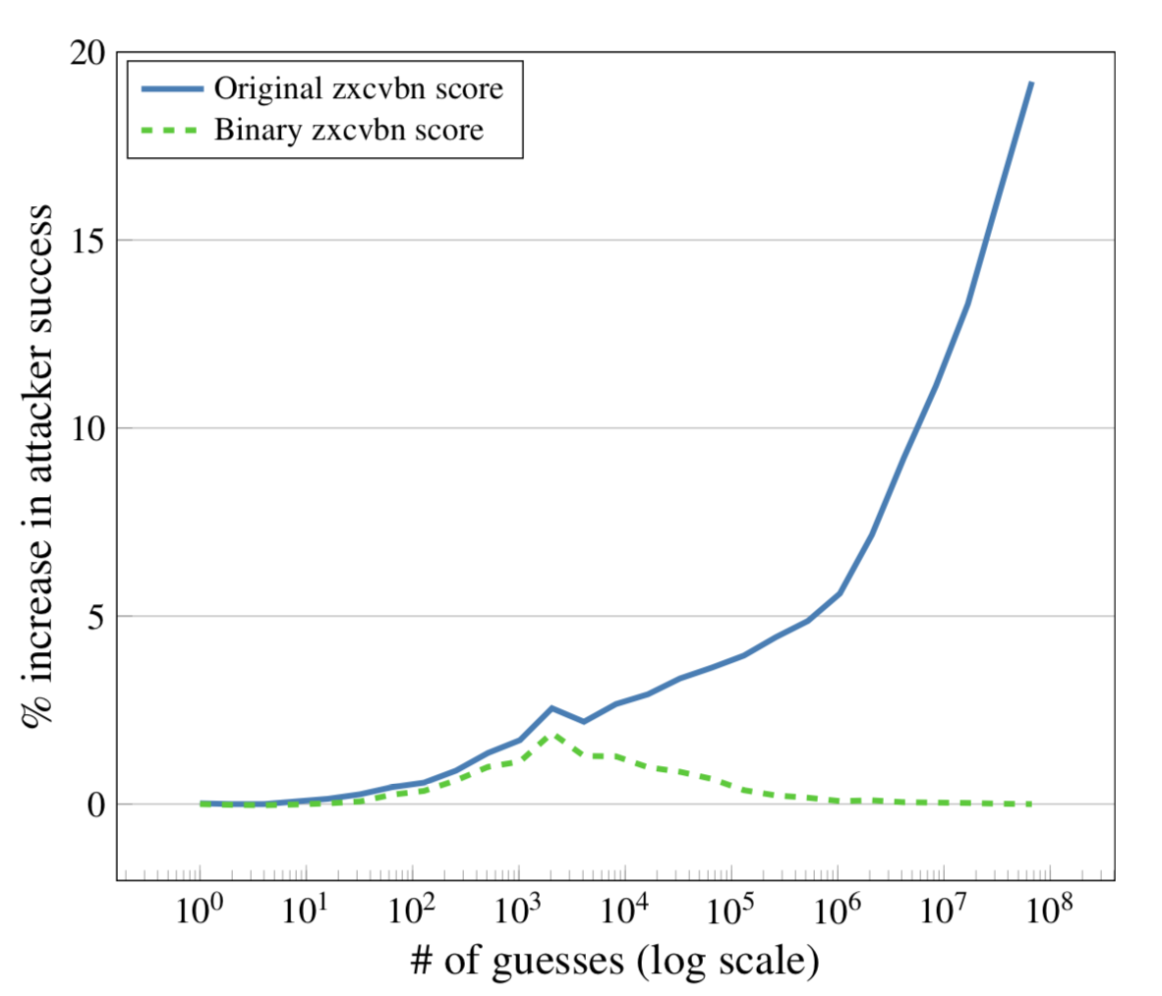

How can we choose safe measurements to log?
Dataset: 307 million breached passwords
Attacker’s guess list: 80% split
Target passwords: 10k passwords sampled from remaining 20%
Problem: Original zxcvbn score leaks too much information!
< 2% increase
Solution: Bucketize score to [0, 1]
Bounded leakage logging
Notes:
We performed a simulation of this scenario using a breach dataset of 307m passwords, where we took 80% as the attacker’s guess list and sampled 10k of the remaining 20% as the target passwords; and we graphed the percent increase in attacker success from the baseline without any pw-derived information. The solid blue line shows that the original zxcvbn score significantly * increases attacker success. So we tried *bucketizing the score, which originally returned an integer between 0 and 4, to a binary 0 or 1. As shown by the green dashed line, the binary zxcvbn score *never allowed an increase in attacker success of over 2%, and *past 100,000 guesses there was an improvement of less than 0.1%--in other words, already weak, easily-guessable passwords may be guessed, but stronger passwords will not be more easily guessed.
So in this case we chose to log the binary score to satisfy our *design principle of bounded leakage logging, and we repeated this simulation for other password derived measurements.

Slide 9
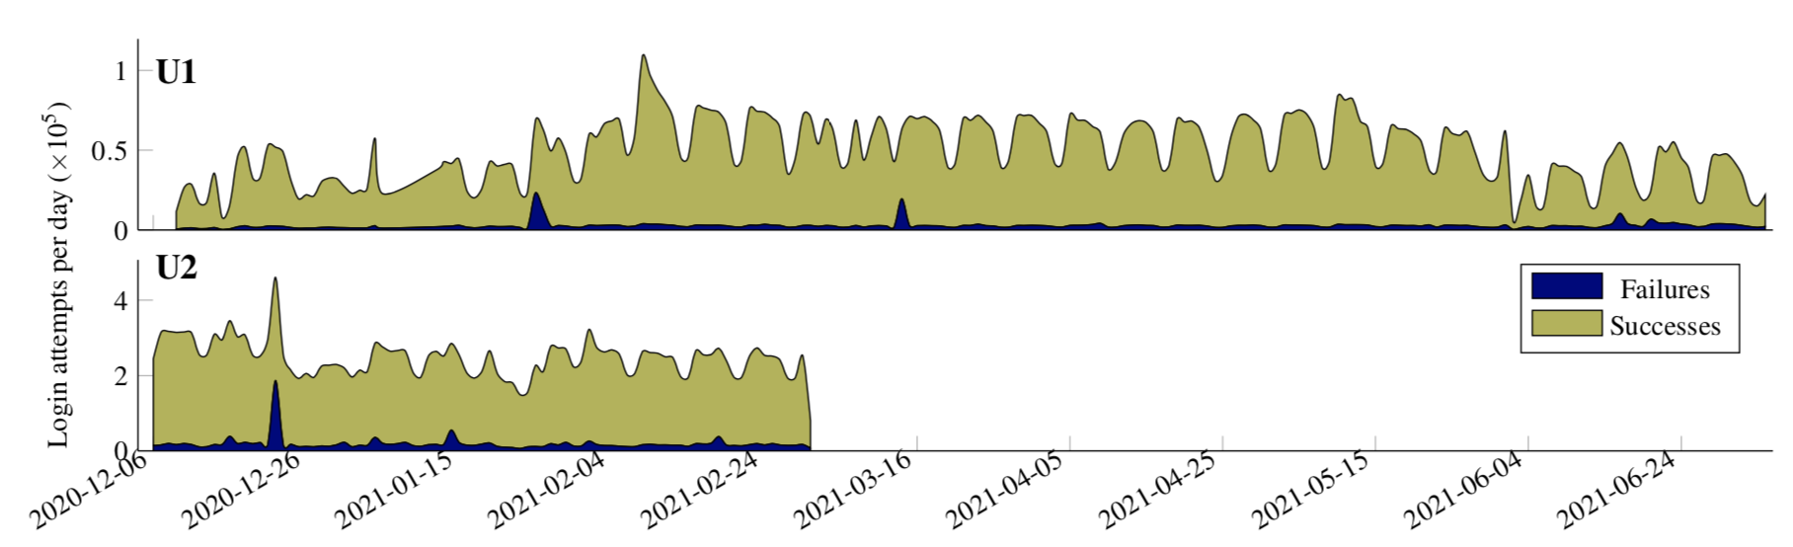
Deploying Gossamer
Observed some high-volume attacks
Attack 1
Attack 2
Accounts for 54K requests at U1
7 months
3 months
Attack 3
Accounts for 81K requests at U2
Obtained approval from respective IRB and the IT offices.
Collected 34M total login requests
Notes:
Given our secure design, we worked with two university security teams to deploy Gossamer in a first-of-its-kind measurement study. We deployed Gossamer for seven at U1 and three months at U2 after *obtaining approval from the respective IRB and IT offices. *Throughout this time period, we observed 34M total login requests. This timeline shows successes by time in light green and failures in dark blue. On this graph we can see a few *big spikes in failed requests, which we confirmed to be attacks through manual analysis.
*In the first attack, we observed four IPs conduct a coordinated credential stuffing attack spanning two days and successfully compromising 23 accounts.
*In the second, we observed one IP conducting a credential stuffing attack using the tool Sentry MBA, successfully compromising 14 accounts.
*In the third, which was at U2, we observed 12 Ips conducting a naïve password spraying attack by pretending to send requests from SMTP and IMAP clients. None of the 76K usernames it tried, though, were valid U2 usernames, so it did not successfully compromise any accounts.
We removed traffic from these three attacks for subsequent analyses to avoid skewing the statistics.
*These high-volume attacks account for 54k requests at U1 which were removed and *81K requests at U2.

Slide 10



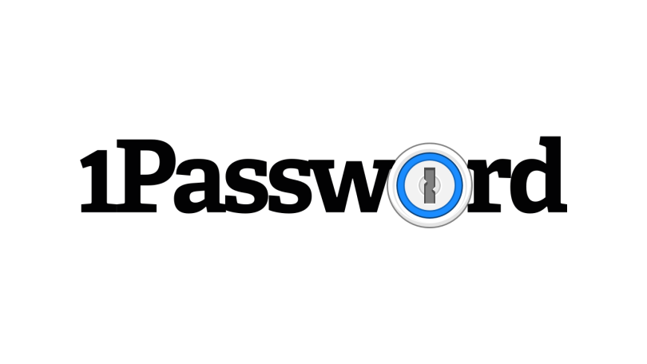

Login friction is still high
Typos are frequent
Over 1 in 3 failed requests at U1 were typos. Even more for mobile logins.
Retries are common
1/5 at U1
1/3 at U2 eventually successful sessions required more than one attempt.
2FA impedes usability
Duo adds an average of 14 seconds to a user’s login.
marina123
marina1223
actual password
typo
Password managers could help…
About 25% of users use password managers.
Notes:
We then performed analysis on the remaining non-attack data. In our analyses, we found that login friction is still high.
*Typos are even more common than reported in prior work (Chatterjee et al.); over 1 in 3 failed requests at U1 were typos, and even more for mobile logins.
*Retries are common. 1 out of 5 eventually successful sessions at U1 and 1 out of 3 at U2 required more than one attempt.
*And two-factor authentication impedes usability, adding an average of 14s to a user’s login for a Duo push.
*Password managers could help with the first two issues. By looking at the number of users with at least 10 successful logins and no failures, and we estimate that about 25% of users are already using password managers.

Slide 11
Breached credential use is a problem.
23 U1 users and 254 U2 users were using a breached password.
Over 2K U1 users and 1K U2 users were using a tweaked breached password
The high-volume attacks had high fractions of breached passwords.
marina123
marina1234
breached password
tweaked password
Next: Investigate how to detect attacks better using these measurements
Solution: Proactive breach alerting
Thomas et al. 2019, Li et al. 2019, Pal et al. 2022
Notes:
We also looked at the use of breached credentials and found that is a big problem.
We saw * 23 users at U1 and 254 at U2 were still using a breached password. *We also saw that over 2K users at U1 and 1K users at U2 were using a close variant of a breached password (or a “tweaked” password). *We believe the solution to this is proactive breach alerting when a user logs in or sets a new password. The solution proposed by Pal et al., Might I get Pwned, is actually also being presented in this conference.
*We also saw that the high volume attacks had high fractions of breached passwords, and *next we plan to investigate how to detect password guessing attacks better using password-derived measurements.

Slide 12
Gossamer
Safely record information about submitted passwords
  Bounded leakage logging
  Assess risk; reduce granularity
Extend with additional measurements
  Simulate improvement in attack
Gain insight into user and attacker behavior
  Can inform new policies
  Develop countermeasures
https://cs.cornell.edu/~marina/gossamer
Marina Bohuk | marina@cs.cornell.edu
Mazharul Islam | mislam9@wisc.edu
Notes:
In conclusion, *Gossamer is a measurement framework for safely recording information about submitted passwords by conforming to design principles such as bounded leakage logging.
*Gossamer can be extended with additional pw-derived measurements, and the potential risk of such measurements can be evaluated using our simulation of guessing attacks.
*We hope that the measurements enabled by Gossamer can be used to gain insight into user and attacker behavior, which can inform new login design policies and the development of attack countermeasures.
We plan to make Gossamer open source so that it can be used and extended by other groups.
Thank you for listening! *We have a website with more details on Gossamer at the link on this slide. *My coauthor Mazharul will be able to answer questions in-person now, or feel free to send me an email.

